Slide 1
Naïve Bayes Flashcard

Slide 2
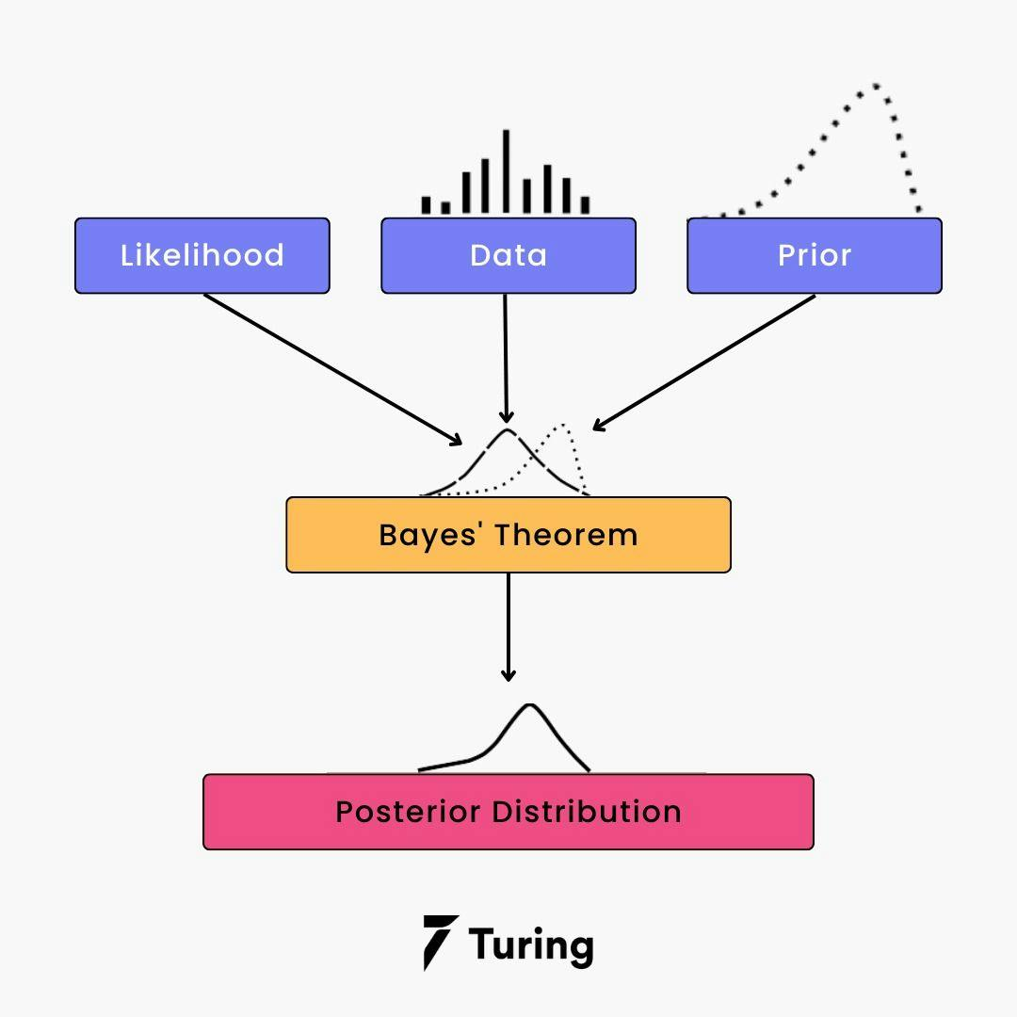
Question
What is Naïve Bayes algorithm and what is its primary assumption

Slide 3

What is Naïve Bayes?
P(C|X): Posterior probability of class C given feature X
P(X|C): Likelihood of feature X given class C
P(C): Prior probability of class C
P(X): Evidence, the overall probability of feature X
Naïve Bayes is a family of algorithms that use Bayes' Theorem to predict the probability of a data point belonging to a particular class.
The core idea is to calculate the posterior probability P(C|X) the probability that a given data point belongs to a class C, given the features X.

Slide 4
Primary Assumptions – Naïve Bayes
The "naïve" part of Naïve Bayes comes from its key assumption: all features are conditionally independent given the class.
In simpler terms, this means that the presence (or value) of one feature does not affect the presence (or value) of another feature, given the class
For example, if we’re classifying emails as spam or not spam, Naïve Bayes assumes that the occurrence of specific words like "discount" and "limited" are independent of each other, given whether the email is spam
This assumption simplifies the computation of the likelihood P(X∣C). Instead of needing to compute a joint probability for all features together, which can be computationally expensive, we compute the product of individual probabilities
P(X|C) = P(x_1|C) * P(x_2|C) * …. * P(x_n|C)

Slide 5
Example
Credit Risk Analysis:
For example, a bank can use historical data on loan defaults to calculate the prior probability of a borrower defaulting on a loan.
As new information becomes available, such as changes in the borrower's credit score or financial statements, the bank can update its prior probability using Bayes' Theorem to obtain a more accurate estimate of the borrower's credit risk
This allows the bank to make better-informed decisions on loan approvals, interest rates, and collateral requirements.

Slide 6
Question
Can you explain the difference between Gaussian, Multinomial and Bernoulli Naïve Bayes

Slide 7
Types of Naïve Bayes
How it works: For a given feature, the likelihood 𝑃(x|C) is calculated using the probability density function of the Gaussian distribution.
Gaussian Naïve Bayes is ideal for datasets where features are continuous and approximately normally distributed
Examples:
Predicting if a patient has a disease based on vital statistics (e.g., blood pressure, heart rate).
Classifying images based on pixel intensity values.
Naïve Bayes is a family of algorithms based on Bayes' Theorem, and the difference between the types—Gaussian, Multinomial, and Bernoulli—lies in how they handle feature distributions
Gaussian Naïve Bayes
Gaussian Naïve Bayes assumes that the features are continuous and follow a normal (Gaussian) distribution. It’s commonly used when dealing with numerical data

Slide 8

Types of Naïve Bayes
Use Case: Multinomial Naïve Bayes is widely used in text classification tasks, where features are word counts or term frequencies
Examples:
Spam email detection
Sentiment Analysis
Equation:
n_i,C = Count of feature i in class C
Alpha = smoothing parameter to handle zero probabilities (Laplace smoothing)
m = Total number of features
Multinomial Naïve Bayes
Multinomial Naïve Bayes is designed for discrete data, especially where features represent counts or frequencies.
It models the likelihood P(x|C) as the probability of observing a certain count of a feature within a class
How it works: It calculates probabilities based on the frequency of each feature within each class

Slide 9

Types of Naïve Bayes
Use Case: Bernoulli Naïve Bayes is particularly suited for binary or boolean data, such as:
Document classification, where features indicate whether a word appears in a document
Fraud detection, where features indicate the presence of certain behaviors or conditions
Bernoulli Naïve Bayes
Bernoulli Naïve Bayes is also for discrete data, but it focuses on binary features—whether a feature is present or absent. Instead of using counts, it works with binary indicators (0 or 1
How it works: For each feature, it calculates the likelihood P(x|C) based on whether the feature is present (x_i = 1) or absent (x_i = 0)

Slide 10
Types of Naïve Bayes
Type | Feature Type | Likelihood Assumption | Common use-cases
Gaussian | Continuous | Normally distributed
Multinomial | Discrete (count/frequencies) | Count-based probability | Text classification/NLP
Bernoulli | Discrete (binary) | Presence or absence of features | Binary features, document classification

Slide 11
Question
How does Naive Bayes handle categorical versus continuous features

Slide 12

Handling feature types
How it works: if we have a feature X with distinct categories x1, x2, … , xk. Naïve Bayes computes:
Multinomial and Bernoulli Naïve Bayes are well-suited for categorical data. Bernoulli works specifically with binary features (presence/absence), while Multinomial extends to counts or frequencies
Imagine a dataset for customer churn, where a feature like "Plan Type" could have categories like 'Basic,' 'Premium,' and 'Enterprise.
Naïve Bayes would calculate the probability of each plan type given whether a customer churned or not
Naïve Bayes is quite versatile and can handle both categorical and continuous features, but the way it processes them depends on the type of Naïve Bayes model being used
Categorical Features
When dealing with categorical features, Naïve Bayes relies on frequency counts or probability tables
Assumption: For categorical features, it assumes the features are discrete and takes into account the conditional probability of each category given the class label

Slide 13
Handling feature types
In a medical diagnosis dataset, a continuous feature like "Age" or "Blood Pressure" might be used.
Gaussian Naïve Bayes would model the distribution of these features for different diagnosis classes
Continuous Features
For continuous features, Naïve Bayes uses probability density functions (PDFs) to estimate the likelihood of a feature value given a class. This is commonly done using the Gaussian Naïve Bayes model
Assumption: Continuous features are assumed to follow a normal distribution within each class
Mechanism: For a feature X with value x, the likelihood P(X=x | Y=y) is computed using Gaussian formula

Slide 14
Handling feature types
In real-world datasets, you often encounter a mix of categorical and continuous features. While Naïve Bayes itself doesn’t natively combine them, you can preprocess the data to use the right techniques for each
For categorical features:
Encode them using one-hot encoding or frequency encoding
Use Multinomial or Bernoulli Naïve Bayes
For continuous features:
Scale or normalize them if necessary, and use Gaussian Naïve Bayes

